Slide 1

TO-DO LIST
REACT
“task-3”

Slide 2

To-Do List
Todo Lists are the lists that we generally use to maintain our day-to-day tasks, that we have to do, with the most important tasks at the top of the list, and the least important tasks at the bottom.
▪
NM ID | NAME | BATCH
au820420205013 | Arun R | CF1
au820420205018 | Divya R | CF1
au820420205028 | Jothikumar K | CF1
au820420205033 | Mahalakshmi S | CF1

Slide 3

Task - 3
Create UI and implement various components using react
●
●
●
Set Up a React App
Create Components and Define structure of the components
Style Your App, add CSS to style your components
Integrate the APIs to frontend to ensure the dynamic feature of website
●
●
●
●
●
Install Axios
Update App.js
Modify App.js and component to interact with the JSON Placeholder API for fetching and creating to-do items.
This code will fetch the initial to-do items from JSON Placeholder,
Secure content of post apisx
Evaluation Metric:
● 100% Completion of the above tasks
Learning Outcome
▪
▪
▪
▪
Developing complicated UI using react components
Understanding API Integration
Getting familiar with different type of API calls
CRUD operations and Asynchronous Programming

Slide 4

Step-Wise Description
Import Necessary Libraries: Import libraries ‘Tkinter’ library for creating a graphical user interface (GUI).
Create the GUI Window: Create a GUI window for your To-Do list application.
Create To-Do List Data Structure: Create a list or other data structure to store your To-Do items.
Create Functions for Adding and Deleting To-Do Items:: Define functions to add and delete To-Do items from your list.
Create GUI Elements: Create GUI elements like labels, entry fields, listboxes, and buttons for adding and deleting tasks.
Main Loop: Run the main event loop for the GUI to make it interactive.
Run the Application: Run the application to start the To-Do List.
Summary of your task
The To-Do List application is a simple and user-friendly tool for managing tasks and can serve as a foundation for more advanced task management applications with additional features and persistence.

Slide 5
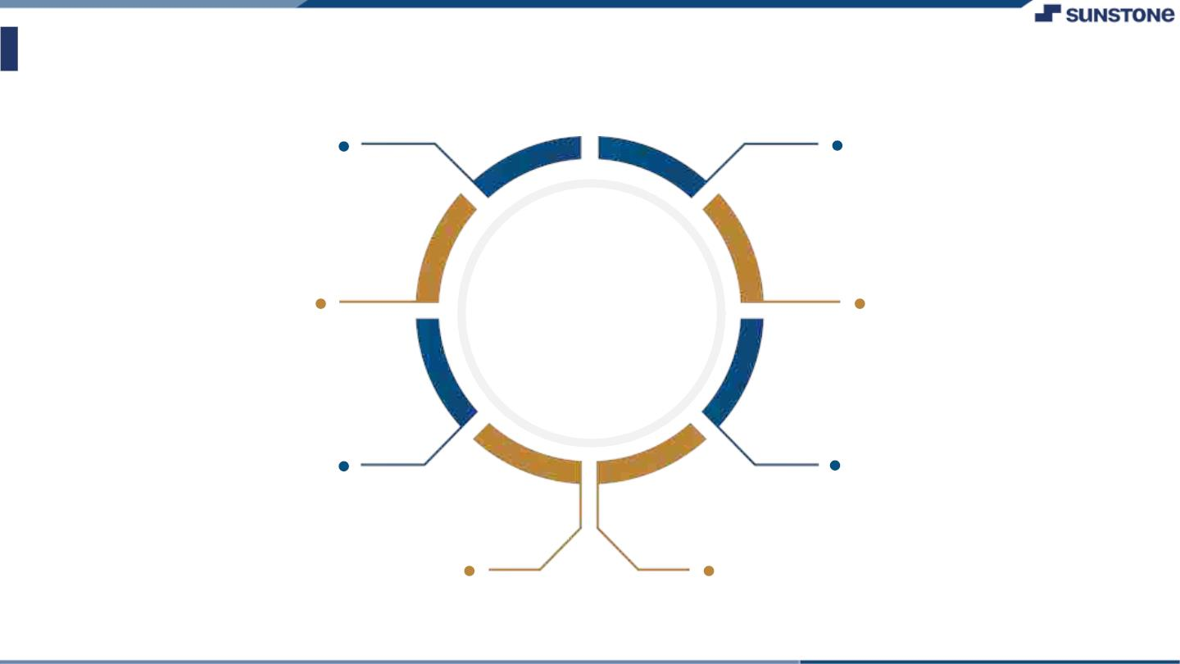
Assessment Parameter
Gather requirements for the
project
Add Readme.md file with description of the project
Prepare database design
schemas
Check-List
Commit all changes with "first commit"
Get your initial project
Structure ready
Create a repository on github realted to project
Initiate a
Initiate a git repository
Push your changes to github

Slide 6

Submission Github
https://github.com/ArunR4/NM2

Slide 7


